Slide 1
Control
Control

Slide 2
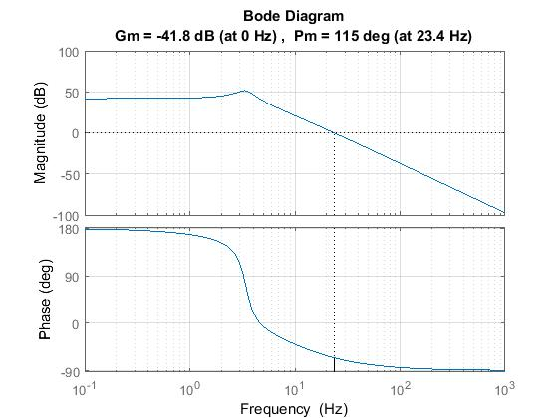
Loopshaping
3Hz
Poles coming from the cart dynamics.
We would like to cancel this behavior.

Slide 3
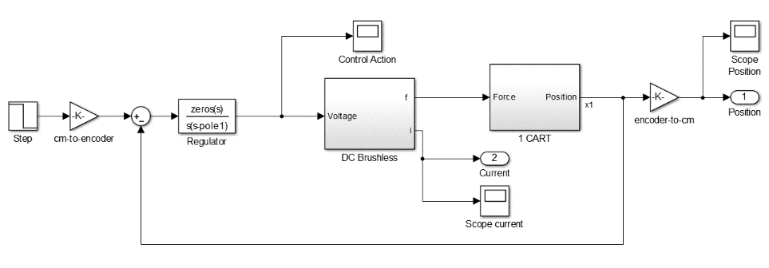
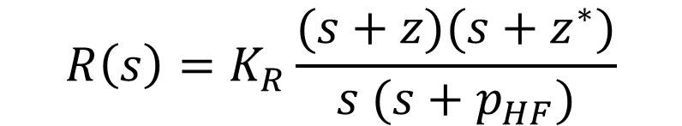
Loopshaping
cancel out cart dynamic
$$R\left(s\right)=K_{R}\frac{(s+z)(s+z^{∗})}{s (s+p_{HF})}$$
Integral action
causal block

Slide 4
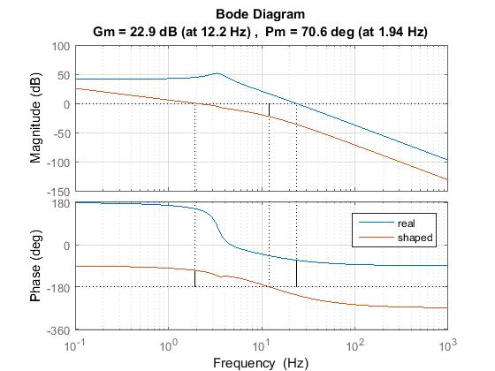
Loopshaping

Slide 5
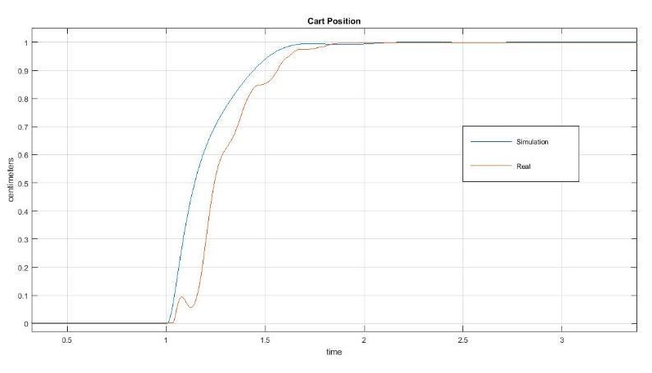
Loopshaping
Transient does not take into account non-linearities,
but rising time and steady-state value match what we expected.

Slide 6
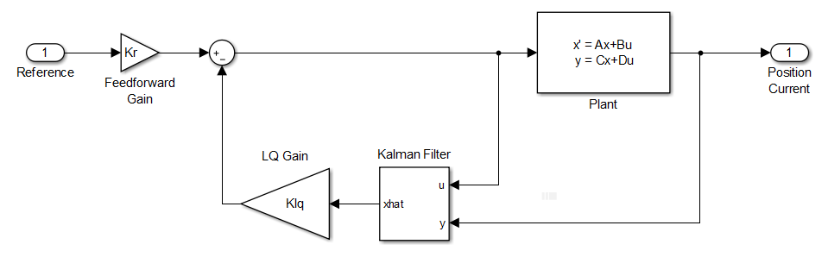
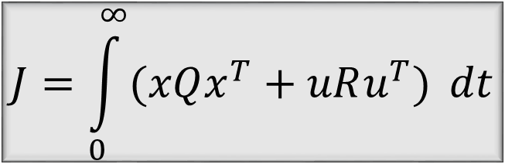
LQG
$$J=\int_{0}^{∞}{(xQx^{T}+uRu^{T})} dt$$
computed in order to guarantee zero tracking error at steady-state.
Notes:
How do we weight Q and R?
Why didnt we include an integral action.

Slide 7
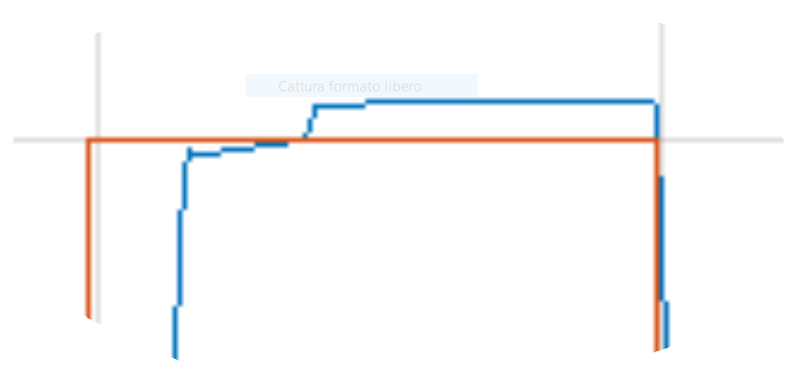
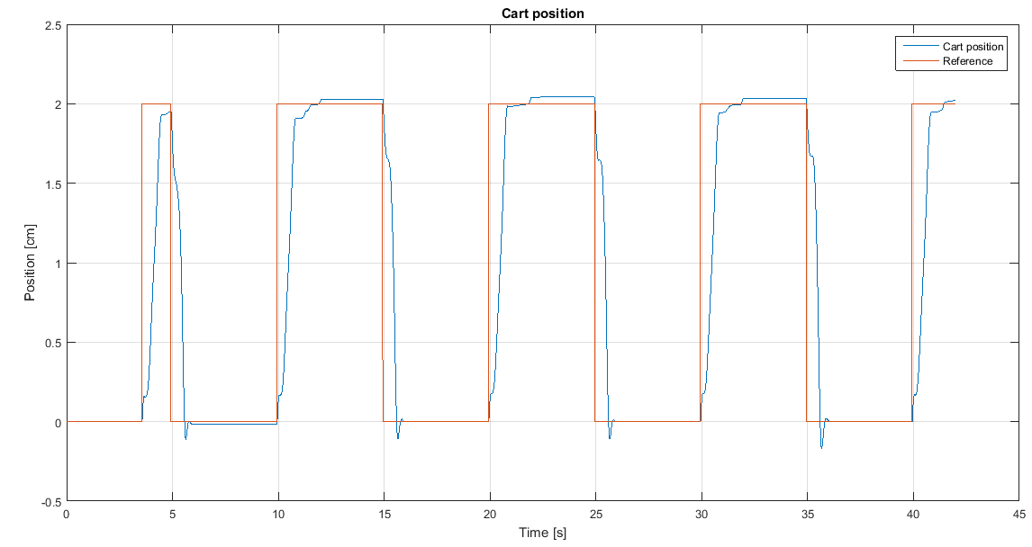
LQG
The compensator is not perfect even though error is below 1/100.

Slide 8
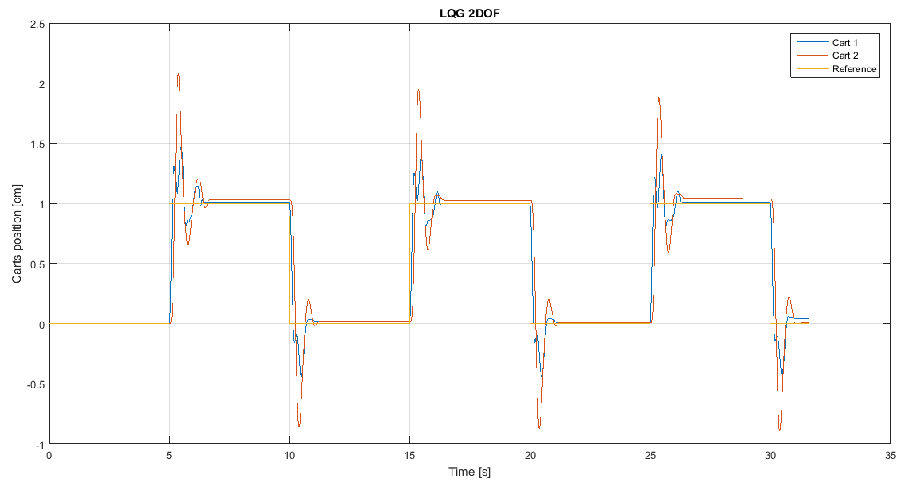
LQG 2dof

Slide 9
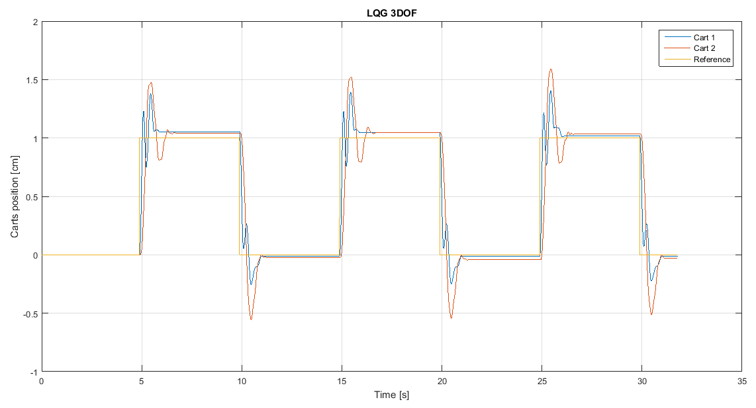
LQG 3dof

Slide 10
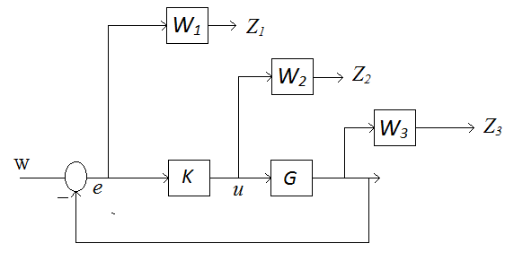

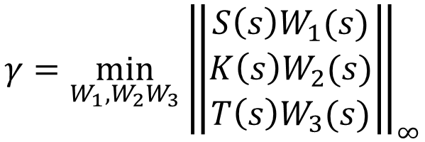
$$H_{∞}$$
$$γ=\min_{W_{1},W_{2}W_{3}}{{\left\|\begin{aligned}S\left(s\right)W_{1}(s) \\ K\left(s\right)W_{2}(s) \\ T\left(s\right)W_{3}(s)\end{aligned}\right\|}_{∞}}$$

Slide 11
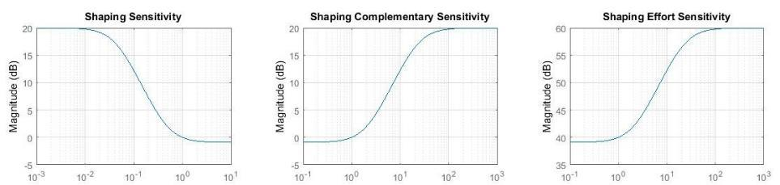
$$H_{∞}$$
1Hz
The weights should have the inverse shape of the desired sensitivity.
The higher the weight the weaker the control action:
It is important since the motor saturates at ±5V.

Slide 12
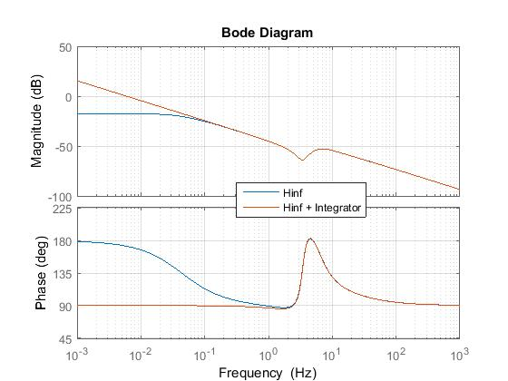
$$H_{∞}$$

Slide 13
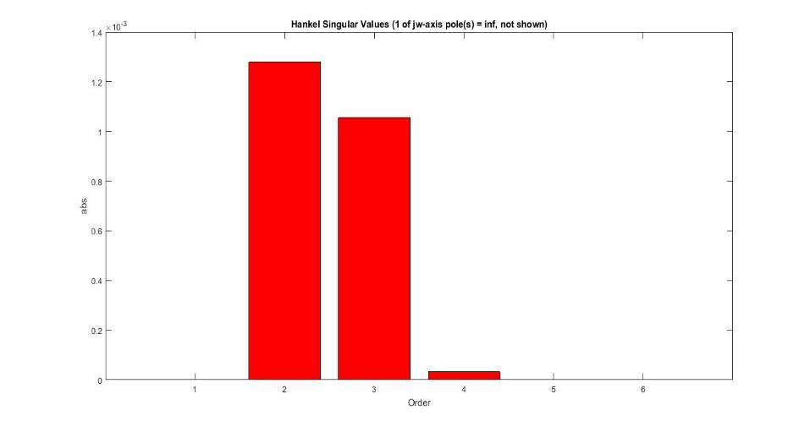
$$H_{∞}$$
Reducing the order of complexity of the regulator does not alter perfomance.

Slide 14
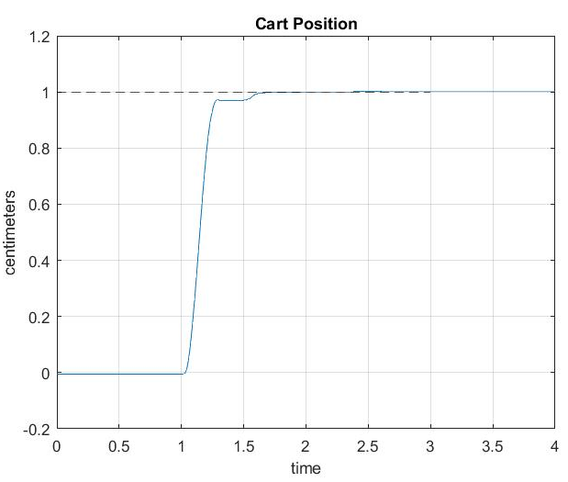
$$H_{∞}$$
Zero tracking error
Rising time less than 1 sec
Noise cancellation

Slide 15
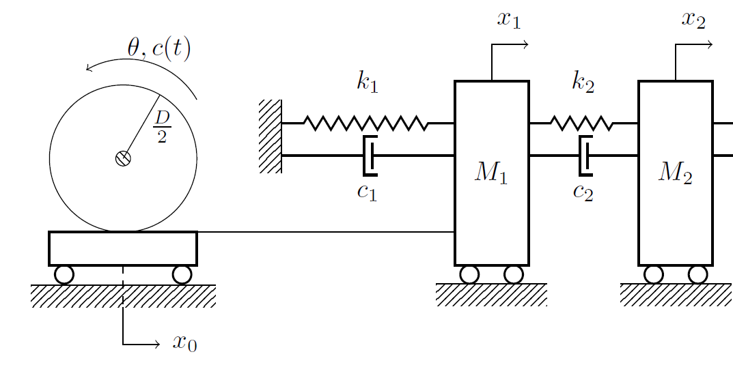
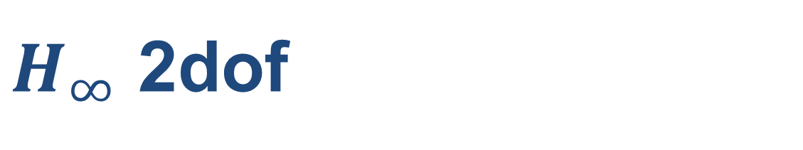
$H_{∞}$ 2dof

Slide 16
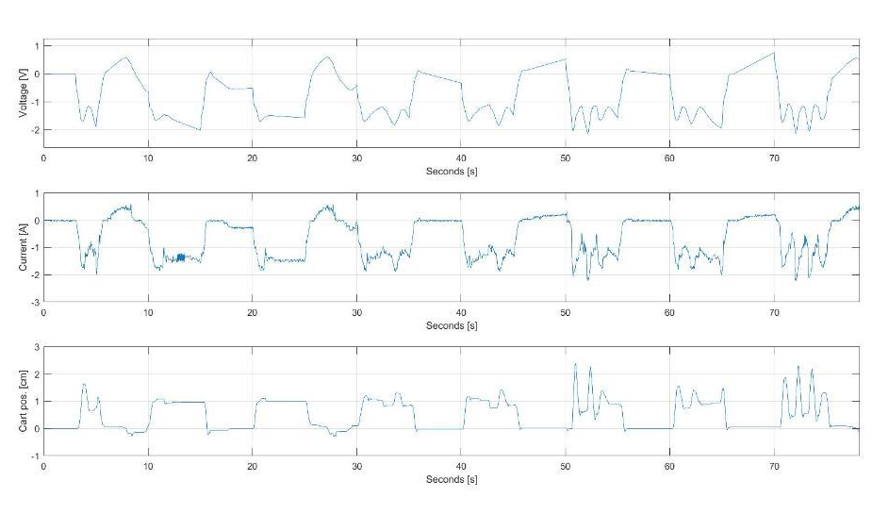
$H_{∞}$ 2dof

Slide 17
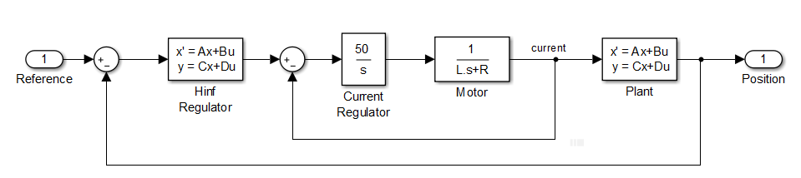
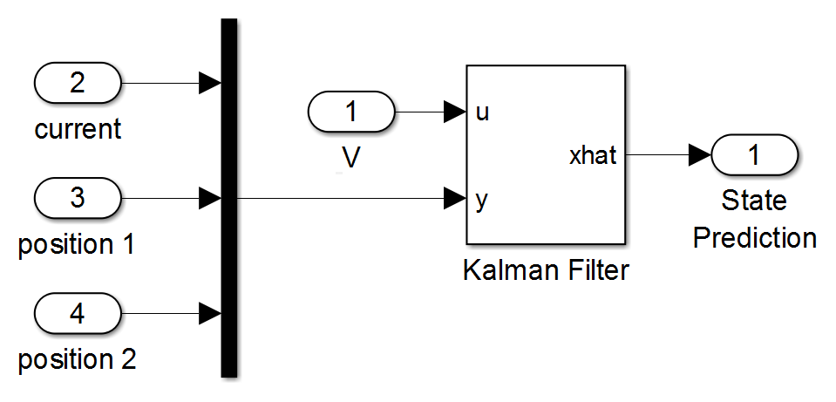
$H_{∞}$ 2dof
The current is not directly measured, but estimated through a Kalman filter.
The current regulator allows to stabilize the motor effort.

Slide 18
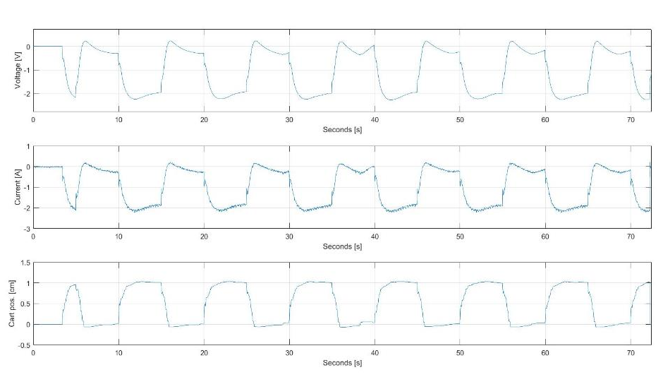
$H_{∞}$ 2dof

Slide 19
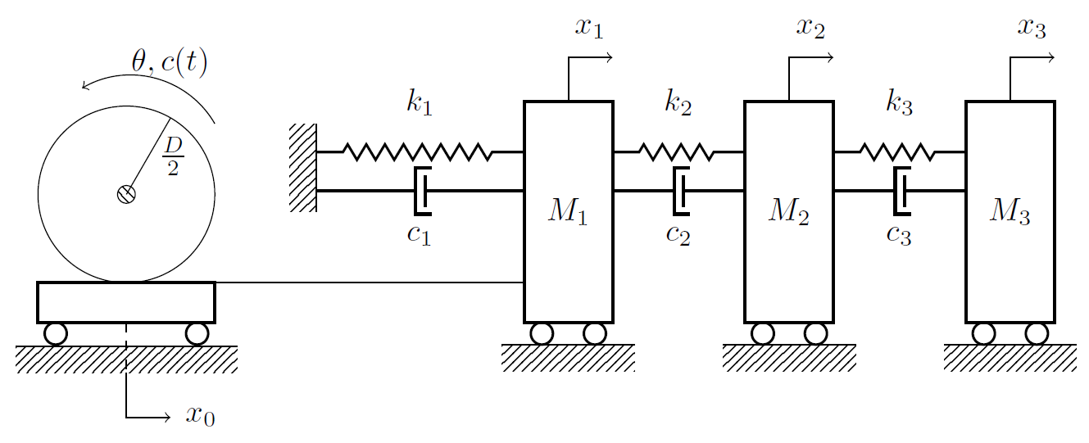
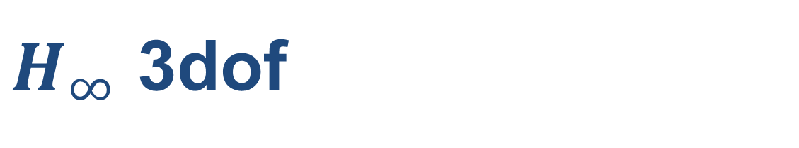
$H_{∞}$ 3dof

Slide 20
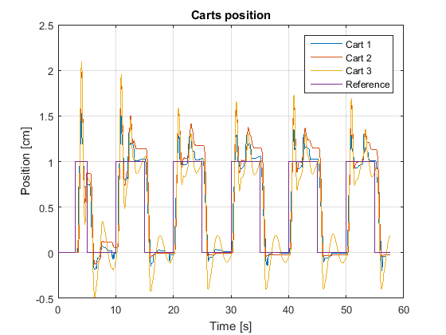
$H_{∞}$ 3dof
The response (although not perfect) is way more stable with the inner current loop.

Slide 21
EKF
Extended Kalman Filter

Slide 22
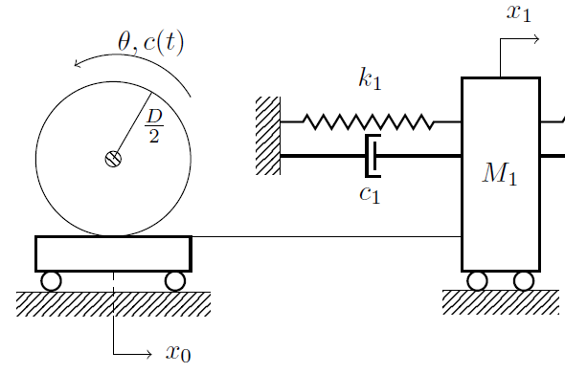
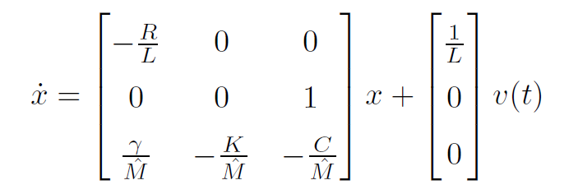
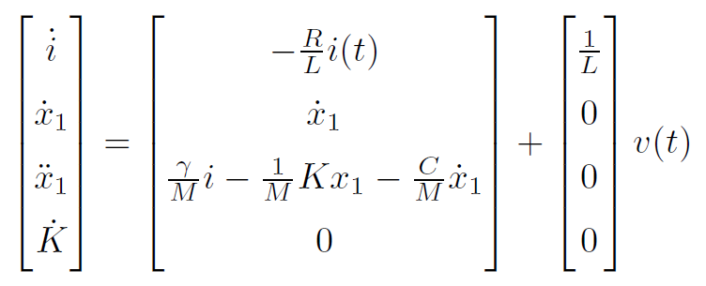
EKF
Linear Model
Nonlinear Model

Slide 23
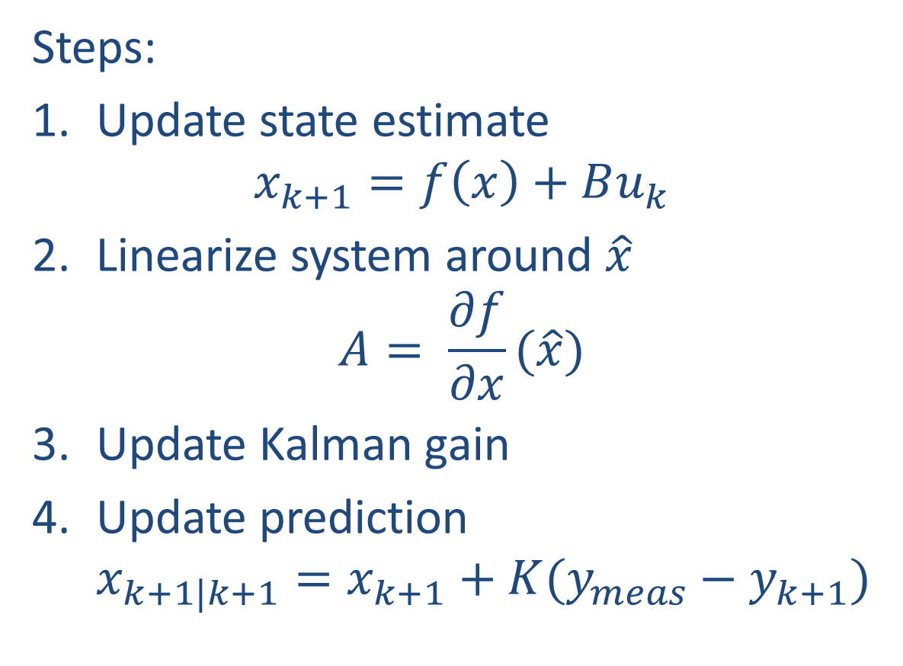
EKF
Steps:
Update state estimate $x_{k+1}=f\left(x\right)+Bu_{k}$
Linearize system around $\hat{x}$ $A= \frac{∂f}{∂x}(\hat{x})$
Update Kalman gain
Update prediction $x_{k+1|k+1}=x_{k+1}+K(y_{meas}−y_{k+1})$
Notes:
Discrete time because it works better.
There is no implementation of EKF on matlab.

Slide 24
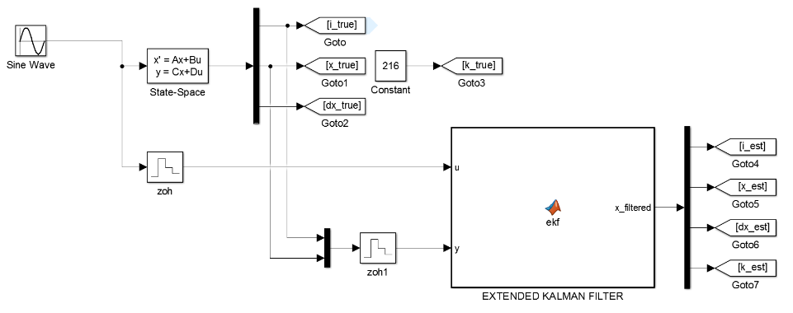
EKF
Simulink simulation
Porting onto Arduino
Validation of results
Notes:
Correctness of implementation
Noisy data, Online
Comparing Arduino vs Simulink = Online vs Offline

Slide 25
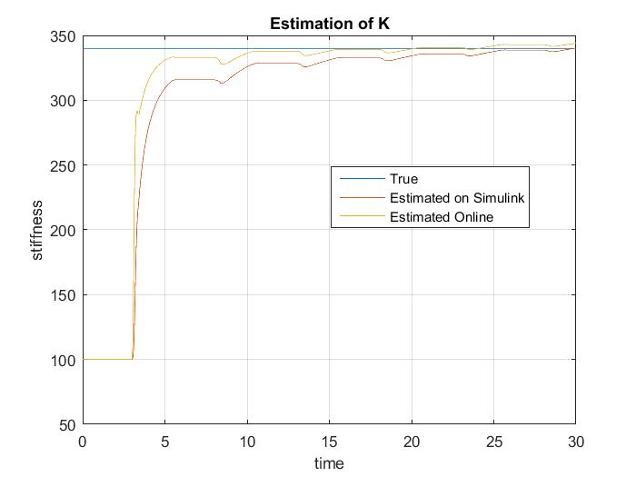
EKF

